Slide 1
IV | III |  |  |  | II | I | Stage of anestesia
 | plane
 | 4 | 3 | 2 | 1
 | deep |  | medium | light |  |  | Characteristic observed | System affected
Acutely dilated |  |  |  | Normal or constricted |  | dilated | pupils | 4- Ocular
absent |  |  |  | Diminishes, lost | +++ | normal | Corneal reflex
absent |  |  | Diminishes, absent | + | +++ | normal | lacrimation
absent |  |  | Diminishes, absent | + | +++ | normal | Palpebral reflex
 |  |  |  | central | variable | normal | Eyeball position
none |  |  |  |  |  | ++++ | nystagmus

Slide 2
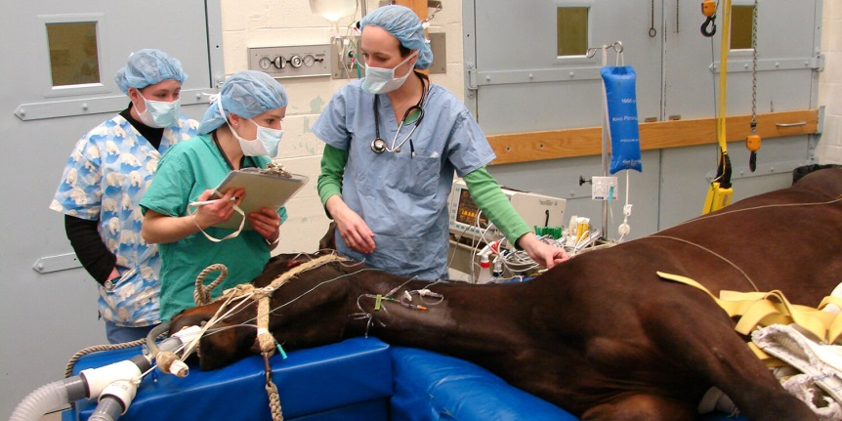
Inhalation anesthetics
Inhalation anesthetics are used widely for the anesthetic management of animals. They are unique among the anesthetic drugs because they are administered , and in large part removed from the body, via the lungs.

Slide 3
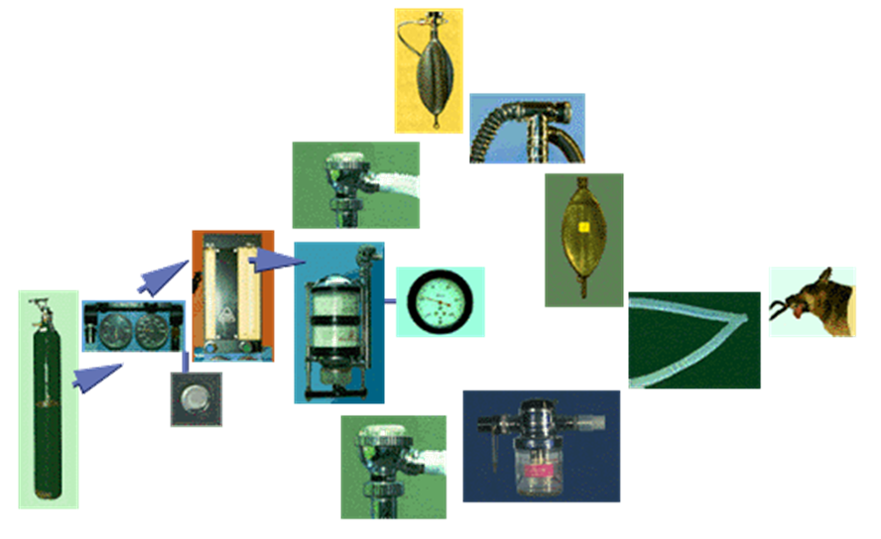
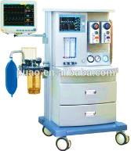
Components of anesthetic machine
● Oxygen source (cylinder or tank)
● Regulator
● Manometer
● Flowmeter
● Vaporizer
● Canister (soda lime, co₂ absorber)
● Reservior bag (4-5 time of tidal volume)
● Corrugated tubes

Slide 4
Breathing systems
Rebreathing (closed)
Chemical absorbant
To and fro
Circle system
Non rebreathing (semiclosed)
Mapleson systems
Magill system
Bain coaxial system
Ayres T-piece

Slide 5
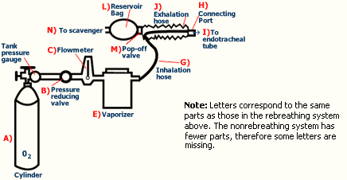
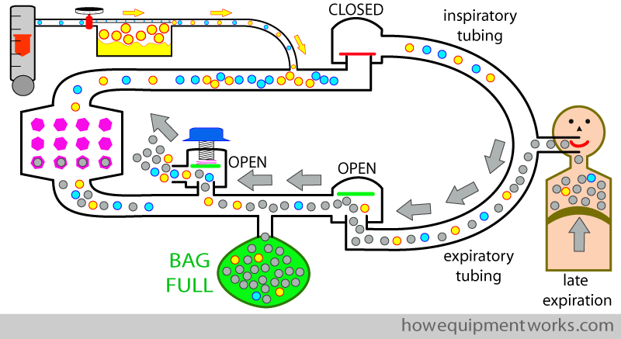
Mechanism of action

